Slide 1

Factors Affecting Foreign Consumer Preferences for
Convenience Food in Taiwan
Pham Cat Ngoc Tuyen (Sinie)
Trinh Thi Cam Tu (Florence)
Giang Thi Ngoc Tram (Nilla)
Tracy Wang
Date: March 11th, 2022

Slide 2

TABLE OF CONTENTS
01
INTRODUCTION
04
RESULTS
Background
Motivation
Purpose
Descriptive Statistics for Demographics
Reliability of Measurement
The Results of Exploratory Factor Analysis (EFA)
The Results of Confirmatory Factor Analysis (CFA)
The Results of Structural Equation Modeling (SEM)
& Hypothesis Testing
The Results of ANOVA
02
LITERATURE REVIEW
Theoretical Background & Hypotheses Proposal
03
METHODOLOGY
05
CONCLUSION REMARKS
Development of Questionnaire
Participants
Analysis Methods

Slide 3

INTRODUCTION
01
Background
Motivation
Purpose

Slide 4



1.1. Background
The worldwide ready-to-eat food products market is predicted to grow with a market value of US$ 195.3 billion by the end of 2026.
The “ready-to-eat food industry" output value of NTD 132.3 billion (28%), an annual increase of 7.43% in 2020.

Slide 5
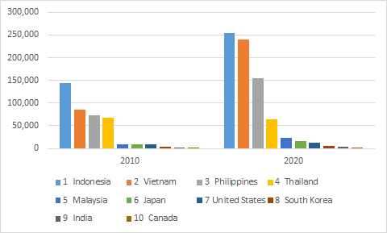

Motivations
Figure 2. The foreign population in Taiwan from 2010 to 2020
253,570
239,039
418,802
154,228
797,122
144,651
~ x2
86,224
72,453
67,326
64,017
47
22,726
15,914
9,396
9,101
9,862
11,861
3,265
5,029
4,497
1,520
2,304
2,568

Slide 6

1.3. Purposes of study
Test the model proposed and to remove inappropriate variables
Examining relationships among determinants
EFA
SEM
CFA
Final result
Data collected from a questionnaire
Assess the validity and reliability of measures
A study that helps food companies understand consumer needs & eliminate what consumers don't want.
Factors affect the food choice of foreign people in Taiwan

Slide 7

LITERATURE REVIEW
02
Theoretical Background and Hypotheses Proposal

Slide 8

Literature Review And Hypotheses Proposal
2.1. Weight Control
Fulkerson et al., (2004): Positive attitudes towards and the frequent eating of low-fat food products are significantly associated with weight-control behaviours.
Oostenbach et al., (2019):​ The most important nutrition claims in weight control are related to fat content and sugar content.
Hypothesis 1. Weight control has a positive impact on repurchase intention of convenience food.

Slide 9

Literature Review And Hypotheses Proposal
2.2. Safety
Gardner, (1993): Another important factor that influences customers' buying decisions and consumption of convenience foods is food safety.
Behrens et al., (2010): The majority of consumers expressed concern about technological rather than ‘natural' hazards. Such are the problems related to food additives, hormones, and pesticides.
Hypothesis 2. Safety attribute has a positive impact on repurchase intention of convenience food.

Slide 10

Literature Review And Hypotheses Proposal
2.3. Sensory Appeal
Braghieri et al., (2016) & Wang et al., (2015): Sensory appeal has been a meaningful factor structuring perception, purchase decision, consumption, and satisfaction of customer.
Pula et al., (2014) & Tan et al., (2017): Taste, ﬂavor, appearance, freshness, texture, smell, and overall liking can affect consumers’ purchase intention and consumption of convenience food.
Hypothesis 3. Sensory appeal has a positive impact on repurchase intention of convenience food.

Slide 11

Literature Review And Hypotheses Proposal
2.4. Nutritional Quality
Pearcey & Zhan (2018) and Prescott et al., (2002): Nutritional quality is another significant aspect that motivates consumers to choose convenience foods, as well as being directly linked to perception, shopping, and consumption.
Georgescu et al., (2016): Nutritional value, natural ingredients, protein content, vitamin content, and nutritional quality certification are motives for consumers' purchase intention and consumption of convenience food.
Hypothesis 4. Nutritional quality attribute has a positive impact on repurchase intention of convenience food.

Slide 12

Literature Review And Hypotheses Proposal
2.5. Convenience
Steptoe et al., 1995 and Lindeman & Vaananen, (2000): Convenience plays a central role in food choice.
Scholderer & Grunert, (2005): The obvious advantage of using convenience food products is saving time.
Hypothesis 5. Convenience has a positive impact on repurchase intention of convenience food.

Slide 13
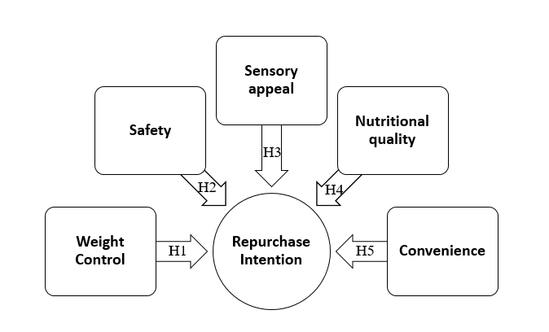
Literature Review And Hypotheses Proposal
Based on previous studies, there are 5 factors that have the most influence on customer repurchase intention of convenience products.
Figure 3. The proposal research framework
Notes:
You can see from 4 factors health, sensory appeal, nutritional quality, safety that affect the purchase intention from which customers consume the product and have satisfaction with that product.

Slide 14

METHODOLOGY
03
Development of Questionnaire
Participants
Analysis Methods

Slide 15

3.1. Development of Questionnaire
The research questionnaire was based on the survey questions studied and utilized by Imtiyaz et al., (2021), and the Food Choice Questionnaire (Steptoe et al., 1995), along with several new questions.
The questionnaire is divided into two parts:
Socio-demographic
Factors:
Weight control, safety, sensory appeal, nutritional quality, & convenience,
Foreign consumers’ repurchase intention of convenience
food.

Slide 16
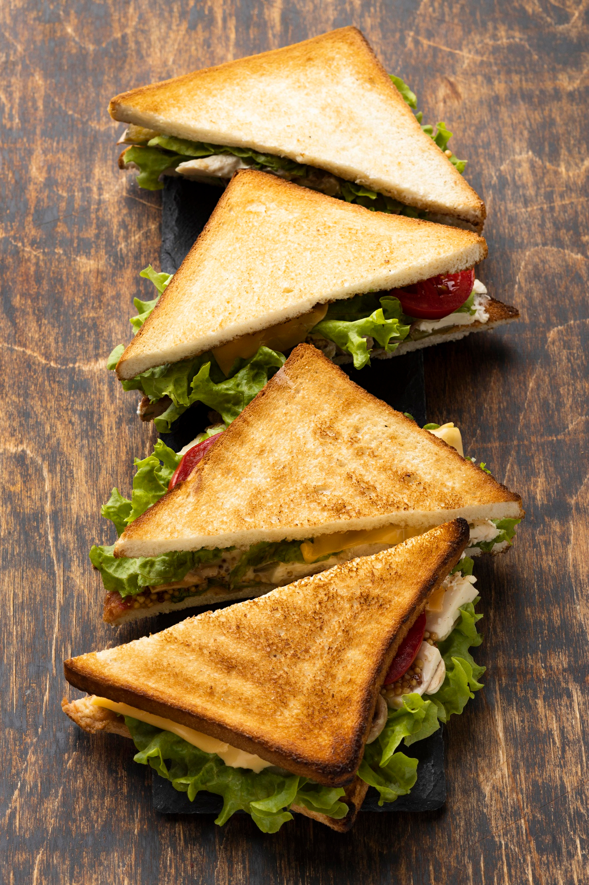
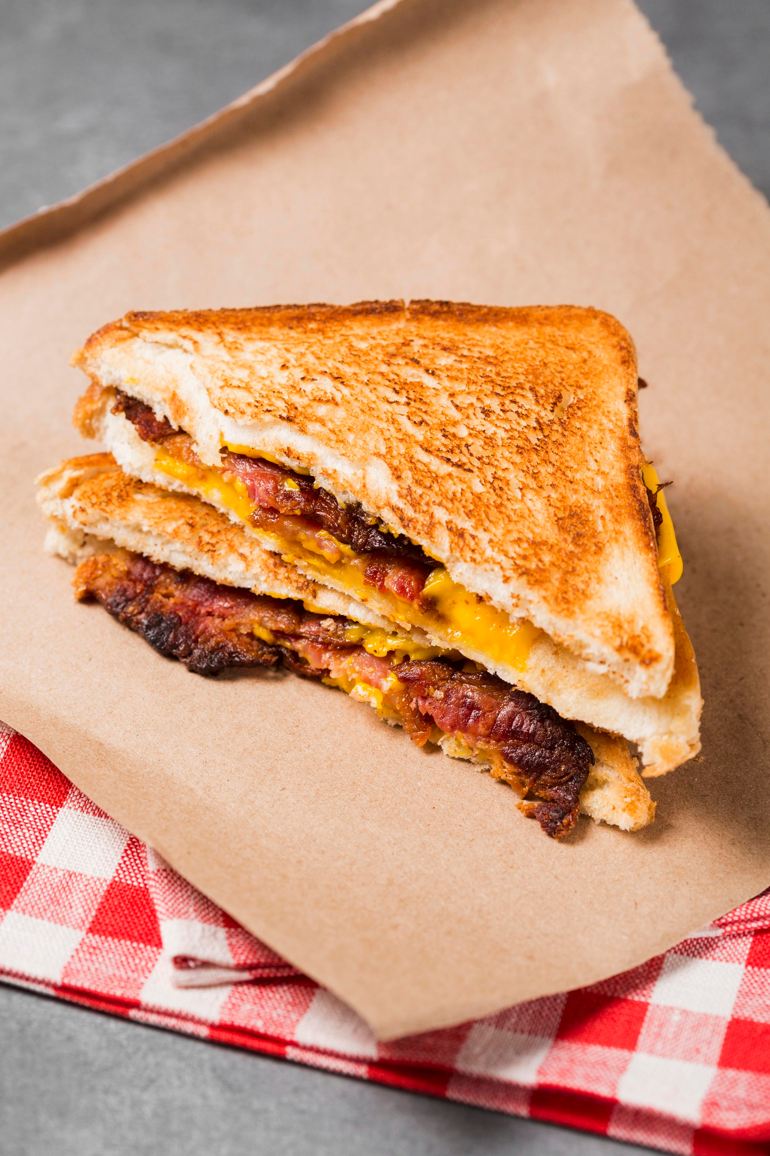
3.1. Development of Questionnaire
There were 49 questions in total:
9 single-answer questions
40 five-point Likert scale questions
Two versions: English and Vietnamese.

Slide 17


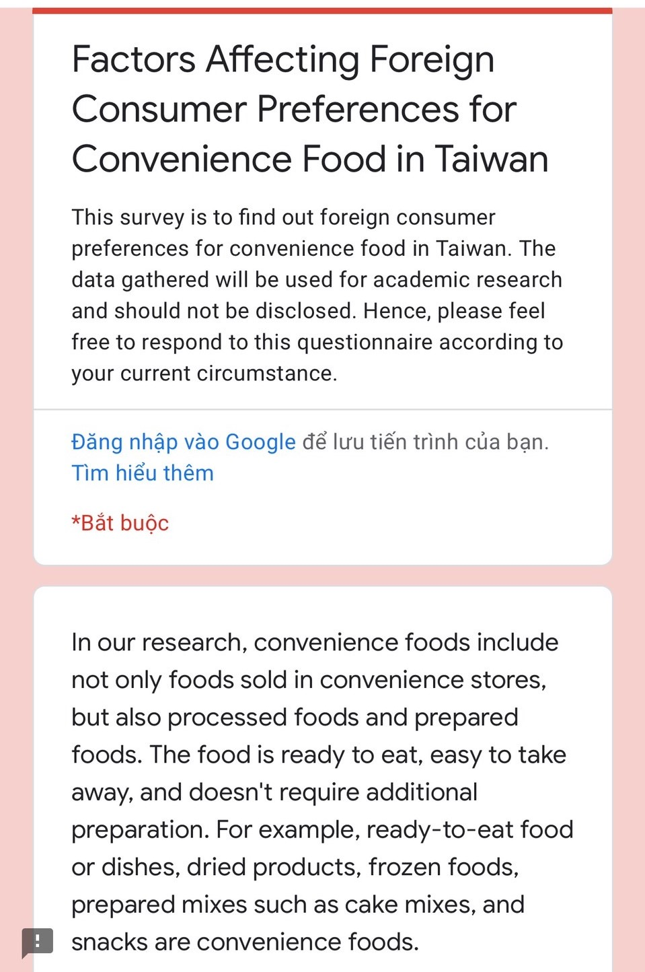
Survey questionnaire versions
Vietnam
English

Slide 18

Description of the questionnaire (English)
Section 1 - Socio-demographic characteristics
Experience on convenience food.
Gender.
Age.
Nationality.
Residence time in Taiwan.
Marital status.
Employment status.
Education level.
Annual income.

Slide 19
Description of the questionnaire. (English)
Section 2 - Weight Control (WEI)
WEI1 - I chose it because it has low calories. (Imtiyaz et al., 2021)
WEI2 - I chose it because it has low fat content. (Imtiyaz et al., 2021)
WEI3 - I chose it because it has low salt content. (Imtiyaz et al., 2021)
WEI4 - I chose it because it has low sugar content. (Imtiyaz et al., 2021)
WEI5 - I chose it because it provides me with a balanced diet. (Imtiyaz et al., 2021)
WEI6 - I chose it because it helps me control my weight. (New)
Section 3 - Safety (SAF)
SAF1 - I chose it because it is free of hormones. (Imtiyaz et al., 2021)
SAF2 - I chose it because it is free of insecticides. (Imtiyaz et al., 2021)
SAF3 - I chose it because it doesn’t contain any non-permissible additives. (Imtiyaz et al., 2021)
SAF4 - I chose it because it doesn’t contain any non-permissible color. (Imtiyaz et al., 2021)
SAF5 - I chose it because it doesn’t contain any artificial ingredients. (Imtiyaz et al., 2021)
SAF6 - I chose it because it has the necessary safety certification. (Imtiyaz et al., 2021)

Slide 20
Description of the questionnaire. (English)
Section 4 - Sensory appeal (SEN)
SEN1 - I chose it because it looks nice. (New)
SEN2 - I chose it because it smells nice. (Imtiyaz et al., 2021)
SEN3 - I chose it because it has a pleasant texture. (Imtiyaz et al., 2021)
SEN4 - I chose it because it tastes good. (Imtiyaz et al., 2021)
Section 5 - Nutritional quality (QUL)
QUL1 - I chose it because of its high nutritive value. (Imtiyaz et al., 2021)
QUL2 - I chose it because it has high mineral content. (Imtiyaz et al., 2021)
QUL3 - I chose it because it has high vitamin content. (Imtiyaz et al., 2021)
QUL4 - I chose it because it contains natural ingredients. (Imtiyaz et al., 2021)
QUL5 - I chose it because it has high fiber content. (Imtiyaz et al., 2021)
QUL6 - I chose it because it has the necessary quality certification. (Imtiyaz et al., 2021)

Slide 21

Description of the questionnaire. (English)
Section 6 - Convenience (CONV)
CONV1 - I chose it because it is easy to prepare. (Steptoe et al., 1995)
CONV2 - I chose it because it can be cooked very simply. (Steptoe et al., 1995)
CONV3 - I chose it because it takes no time to prepare. (Steptoe et al., 1995)
CONV4 - I chose it because it can be bought in shops close to where I live or work. (Steptoe et al., 1995)
CONV5 - I chose it because it is easily available in shops and supermarkets. (Steptoe et al., 1995)

Slide 22

Description of the questionnaire. (English)
Section 7 - Repurchase intention (RI)
RI1 - I will continue to buy it to control weight. (New)
RI2 - I will continue to buy it due to its safety attributes. (New)
RI3 - I will continue to buy it due to its sensory appeal. (New)
RI4 - I will continue to buy it due to its nutritional quality. (New)
RI5 - I will continue to buy it due to its convenience. (New)
RI6 - I will continue to buy it in the near future. (New)
RI7 - I will continue to buy it on a regular basis. (New)

Slide 23


3.2. Participants
The questionnaire was meant for foreign participants with different age groups and occupations.
The survey received 242 valid responses from 274 responses from foreign individuals living in Taiwan from January to February of 2022.
The respondents were international students at different universities and groups of foreign workers in Taiwan.

Slide 24


3.3. Analysis methodology
Exploratory factor analysis (EFA):
Conﬁrmatory factor analysis (CFA)
Structural equation modeling (SEM)
Testing the model proposed and removing inappropriate variables, which helps the research framework as well as the questionnaire more correct.
Assessing the validity and reliability of measures with statistical indexes.
Examining hypotheses about the relationships among determinants in the theoretical framework.
“Confirmatory factor analysis (CFA) is a statistical strategy specifically designed to identify and explore hypothetical constructs as manifest in fallible indicators.”
Hoyle R.H., (2000)
“Structural equation modeling (SEM) is a powerful multivariate analysis technique that is widely used in the social sciences.”
Gonzalez et al., (2008)

Slide 25

RESULTS
04
Descriptive Statistics for Demographics
Reliability of Measurement
The Results of Exploratory Factor Analysis (EFA)
The Results of Confirmatory Factor Analysis (CFA)
The Results of Structural Equation Modeling (SEM) and Hypothesis Testing
The Results of ANOVA

Slide 26






4.1. Descriptive Statistics for Demographics
Gender
Marital status
Age
Females (58.7%)
Males (40.5%).
79.3% single
20.7% married
18 to 24 years old (49.2%)
25 to 34 years old (28.9%)
Annual family
income (INR)
Employment status
Nationality
NTD 300,000 (62,4%)
NTD 300,000 to NTD 500,000 (19.8%)
NTD 501,000 to NTD 700,000 (8.7%)
Full-time jobs (33,9%)
Part-time jobs (40.5%)
Vietnamese (31.8%)
Indonesian (23.6%)
Filipino (10.7%)

Slide 27
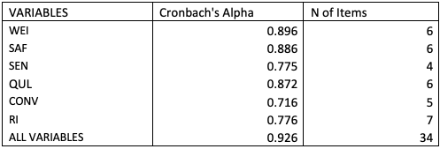
4.2. Reliability of Measurement
0.7 -> test “Valid“.
the questionnaire has a high internal consistency

Slide 28
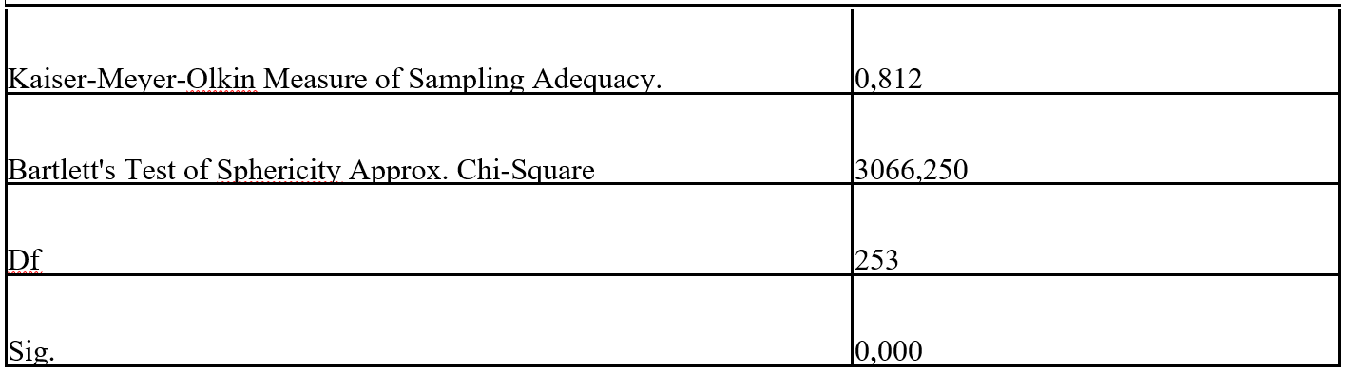
4.3. The Results of Exploratory Factor Analysis (EFA)
Table 4. KMO and Bartlett’s Test of Sphericity
The factor analysis is appropriate.

Slide 29
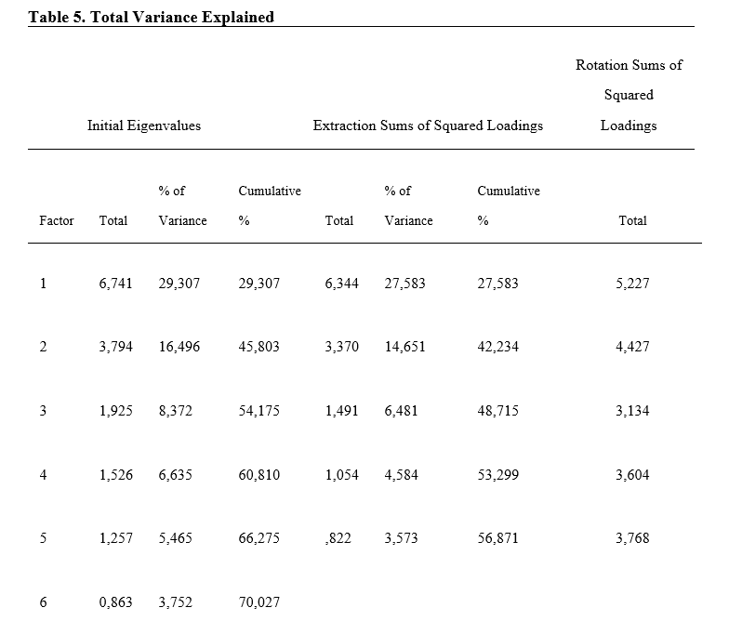
4.3. The Results of Exploratory Factor Analysis (EFA)
The practical significance of EFA is guaranteed.

Slide 30
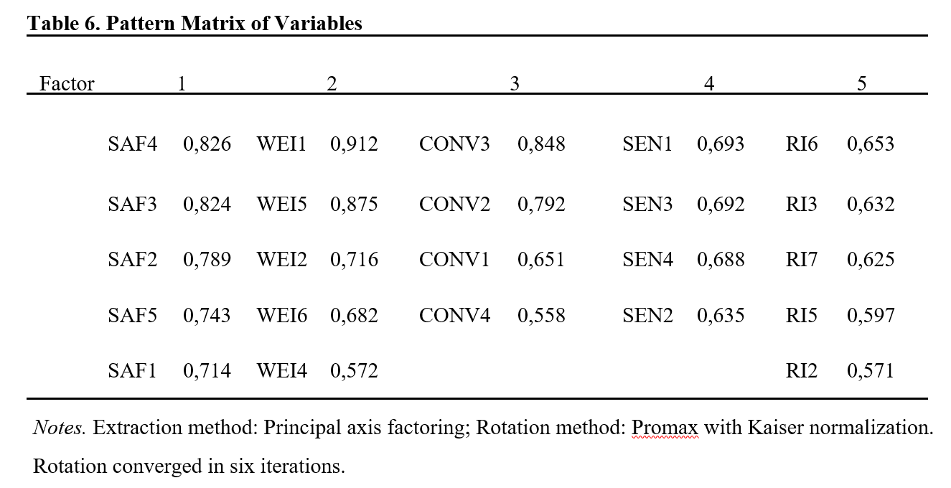
4.3. The Results of Exploratory Factor Analysis (EFA)

Slide 31

4.3. The Results of Exploratory Factor Analysis (EFA)
After adjusting the proposal hypotheses, four hypotheses are included in this conceptual framework:
Hypothesis 1. Weight control has a positive impact on repurchase intention of convenience food.
Hypothesis 2. Safety attribute has a positive impact on repurchase intention of convenience food.
Hypothesis 3. Sensory appeal has a positive impact on repurchase intention of convenience food.
Hypothesis 5. Convenience has a positive impact on repurchase intention of convenience food.

Slide 32
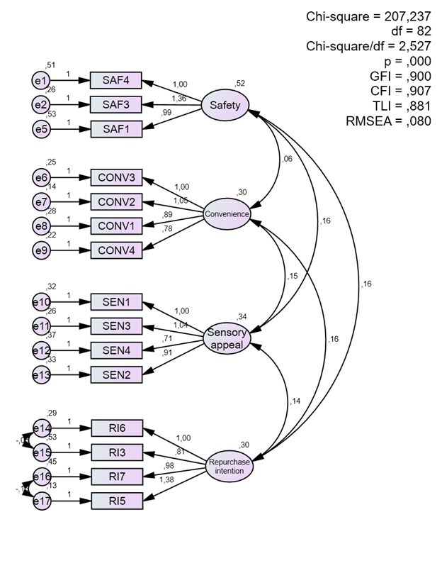
4.4. The Results of Confirmatory Factor Analysis (CFA)
The validity and reliability of measures are proved.
The factor “weight control" is removed due to the inappropriateness in this research model.
Figure 4. CFA result

Slide 33
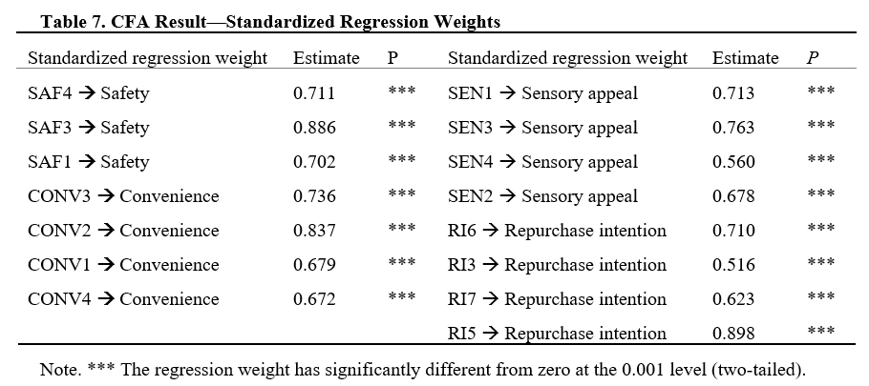
4.4. The Results of Confirmatory Factor Analysis (CFA)

Slide 34

4.4. The Results of Confirmatory Factor Analysis (CFA)
Hypothesis 2. Safety attribute has a positive impact on repurchase intention of convenience food.
Hypothesis 3. Sensory appeal has a positive impact on repurchase intention of convenience food.
Hypothesis 5. Convenience has a positive impact on repurchase intention of convenience food.

Slide 35
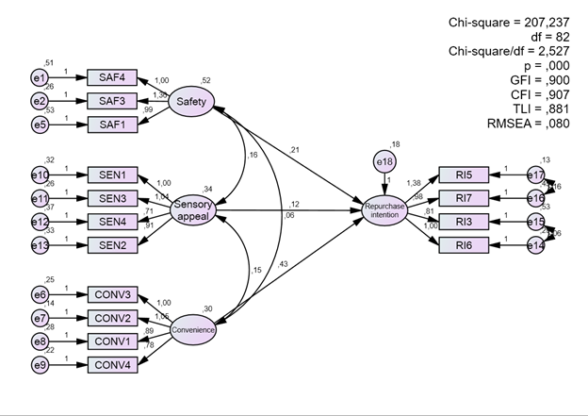
4.5. The Results of Structural Equation Modeling (SEM) and Hypothesis Testing
The indices of model fit are satisfied with the conditions.
→ The relevance of the research framework can be acceptable.
Figure 5. Structural Equation Modeling analysis after adjusting the theoretical model

Slide 36
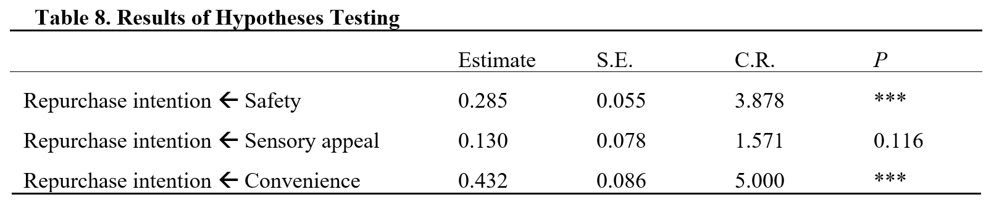
4.5. The Results of Structural Equation Modeling (SEM) and Hypothesis Testing
Based on standardized regression weights and p-value estimation, we can argue that:
Safety positively influences repurchase intention. → H2 is supported.
Convenience positively influences repurchase intention. → H5 is supported.
Based on standardized regression weights and p-value estimation, we can argue that:
Sensory appeal does not significantly affect repurchase intention. H3 is not supported.

Slide 37


4.5. The Results of Structural Equation Modeling (SEM) and Hypothesis Testing
Convenience has a larger impact on foreign consumer repurchase intention than safety.
Weight control, sensory appeal, nutritional quality seem to be not related to foreigners' repurchase intention.
There are 2 factors (safety & convenience) affecting the repurchase intention of convenience food.

Slide 38
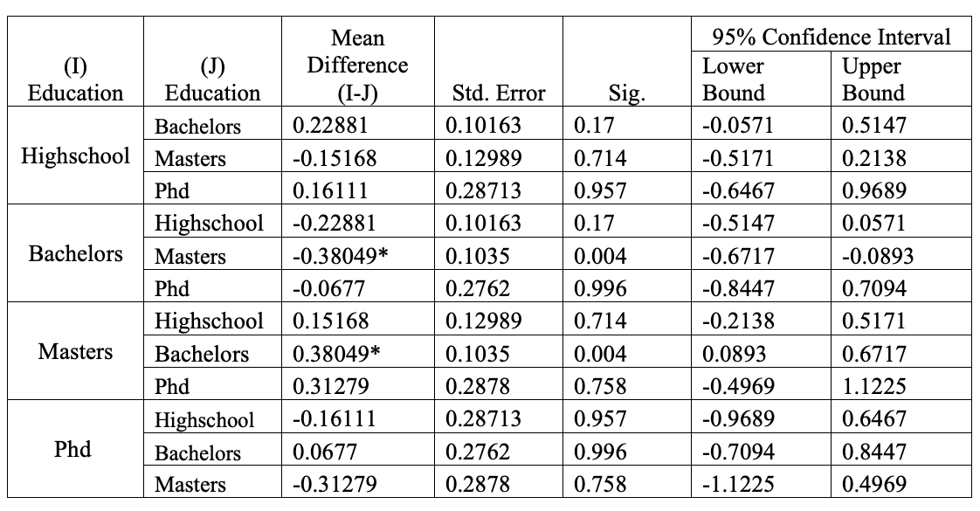
The Results of ANOVA
Table 10. Multiple Comparisons (Education level).
Dependent variable: Repurchase Intention.
Tukey HSD.
*. The mean difference is significant at the 0.05 level.
Master education level does indeed have the highest effect toward foreign consumers’ repurchase intention of convenience food.

Slide 39
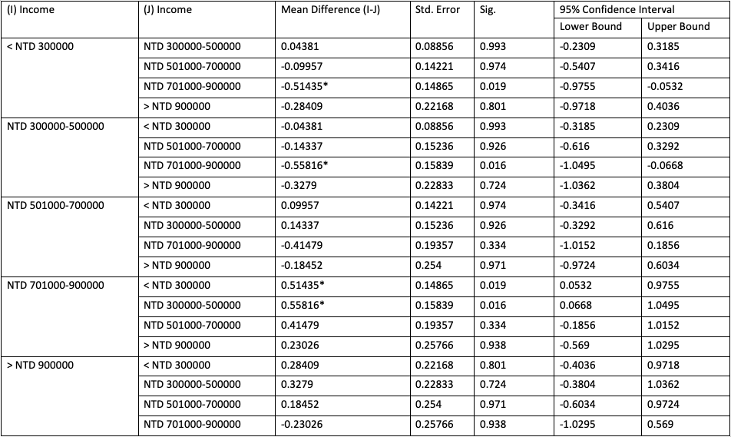
4.6 The Results of ANOVA
Table 12. Multiple Comparisons (Income level).
Dependent variable: Repurchase Intention.
Tukey HSD.
*. The mean difference is significant at the 0.05 level.
High income levels of do have an effect on the repurchase intention of foreign consumers towards convenience food. Specifically, the when the foreign consumers' income level is at NTD 701,000 - 900,000/annually.

Slide 40

CONCLUSION REMARKS
05

Slide 41
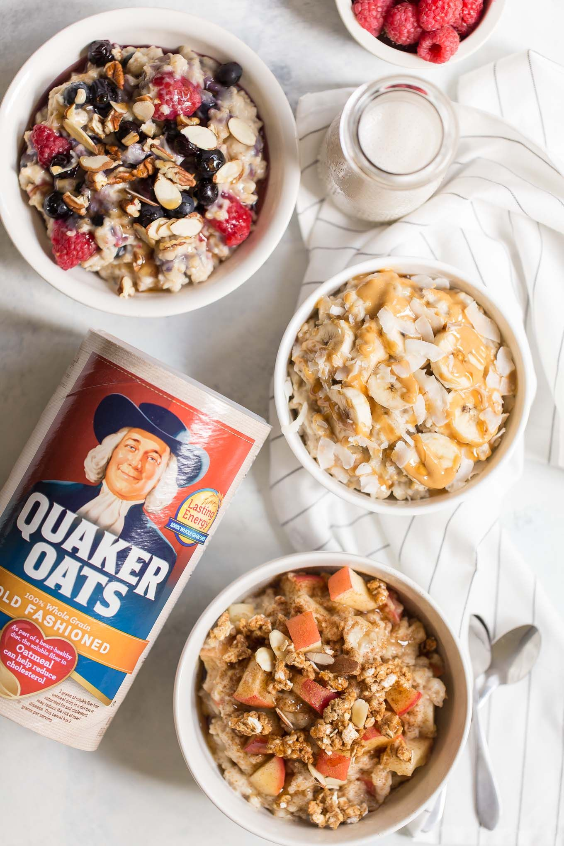


Conclusion Remarks
Only safety and convenience can directly influence repurchase intention of expats in Taiwan.
→ Food producers and marketers should take practical steps to fulfill these aspects for foreign consumers.
Convenience has the most significant effect.
→ International consumers who are more convenience-oriented will be easy to repurchase convenience food.
Reaching international market segmentation and then increasing revenues.

Slide 42




Conclusion Remarks
Consumers’ income level has an obvious impact on the repurchase intention of foreign consumers in Taiwan.
Foreign consumers with a high level of education will have more awareness, requirements with their repurchase intention.
01
02

Slide 43
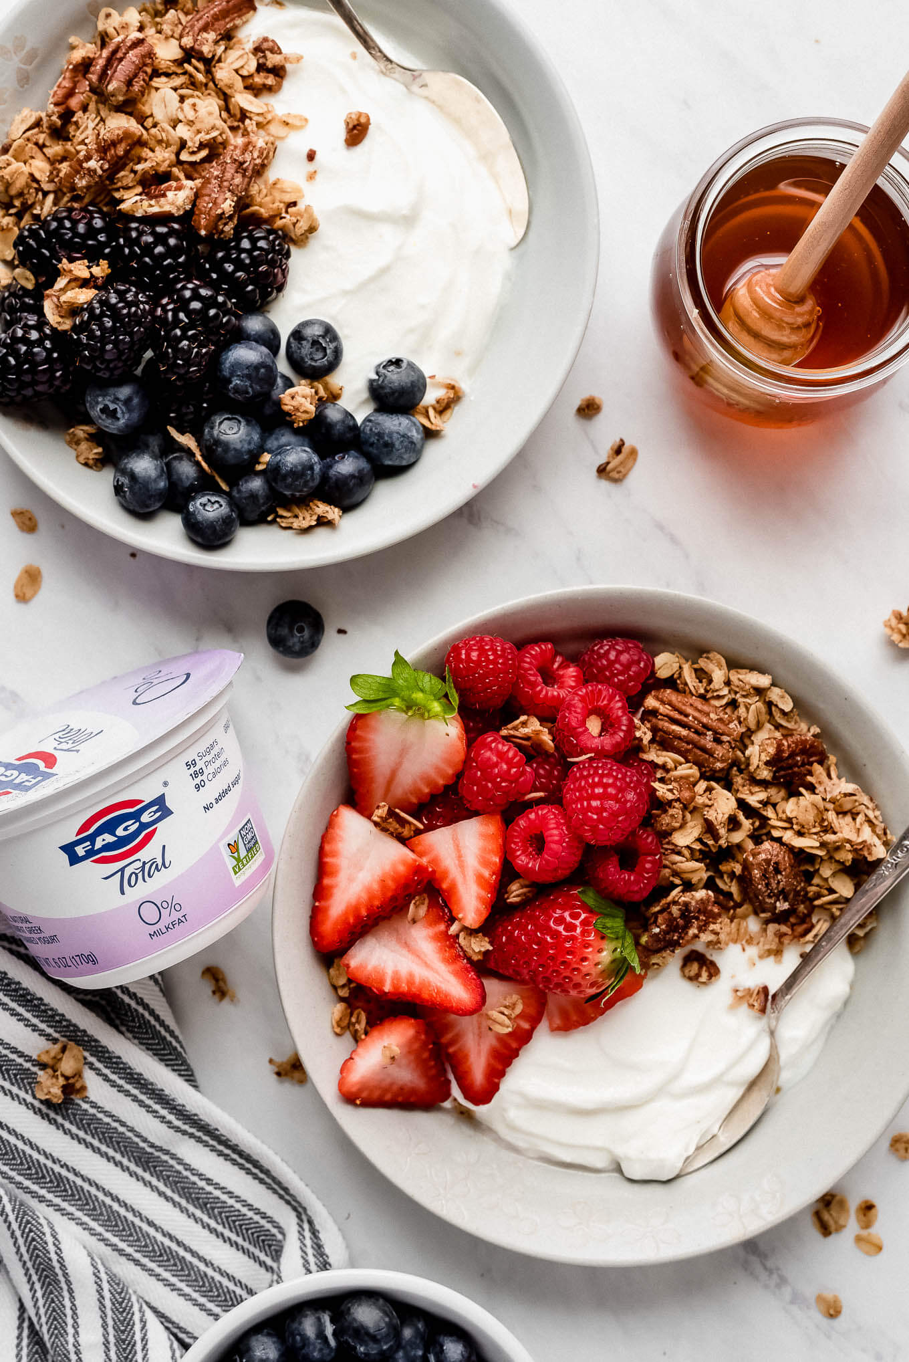

Conclusion Remarks
Based on findings of this study, food suppliers in Taiwan are able to develop and carry out an appropriate allover strategy of convenience food.
Focus on and enhance the aspects such as convenience and safety.
Bring optimal benefits to the foreign customers and themselves.
Our suggestion for further study: Consider the factor relating to environmental sustainability to improve and complement convenience products.

Slide 44

THANK YOU FOR LISTENING!
Do you have any questions and suggestions for us?

